Slide 1

Breaking wireless security systems
William McCann Mercury ISS
IEEE TENSYMP 2018 Workshop

Slide 2

Overview
1. an overview of the talk
2. Wireless security concepts
3. Two targets for evaluation

Slide 3



William McCann
Consultant, Mercury ISS
Penetration Tester
13 years in Australian Army
Electronic Warfare and Cyber
mccannwj
https://wjmccann.github.io

Slide 4
What’s driven this talk?
Convergence of the digital & physical world
We don’t analyse stuff to the depth we should
The (in)security of IOT

Slide 5
A few wireless [security] concepts

Slide 6
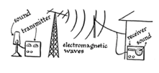
Definition of wireless
Wireless communication is any form of communication transfer between two points that are not physically connected.

Slide 7

Radiofrequency spectrum
Managed by ACMA
We’ll be playing in the ISM bands where most devices live.

Slide 8
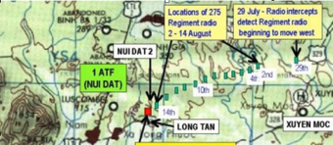
Attacks we can do
Capture
Direction find
Replay
Impersonate
Deny

Slide 9
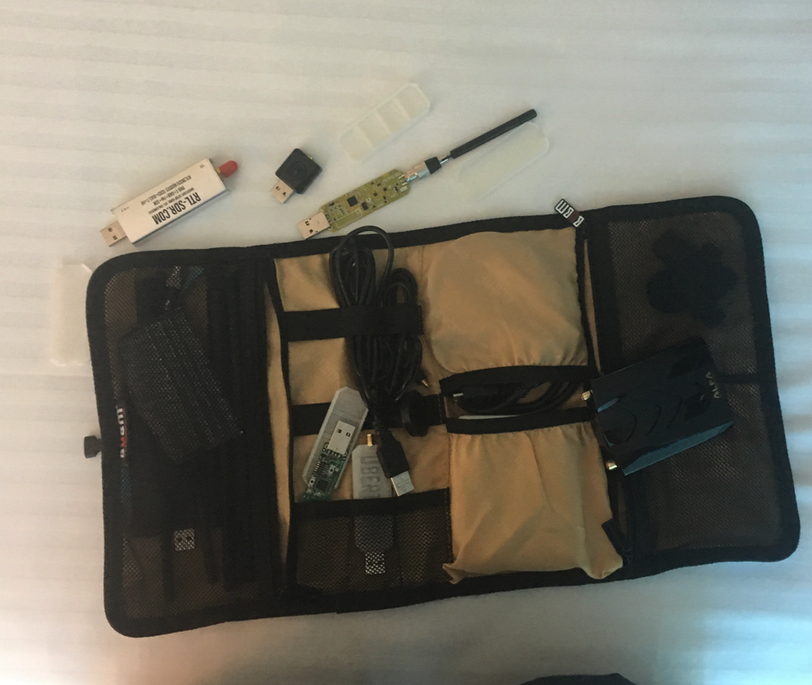
Hardware/kit for wireless security testing

Slide 10
1st target

Slide 11
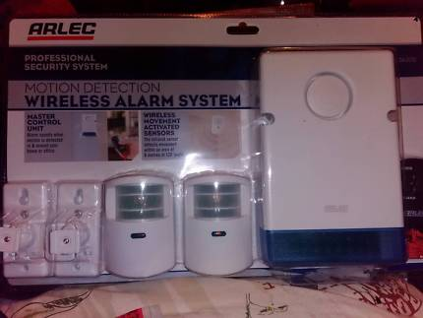
Arlec external siren
Model number DA202-1
Operates between 433-435 MHZ
About $80 from Bunnings
Apparently provides protection?

Slide 12
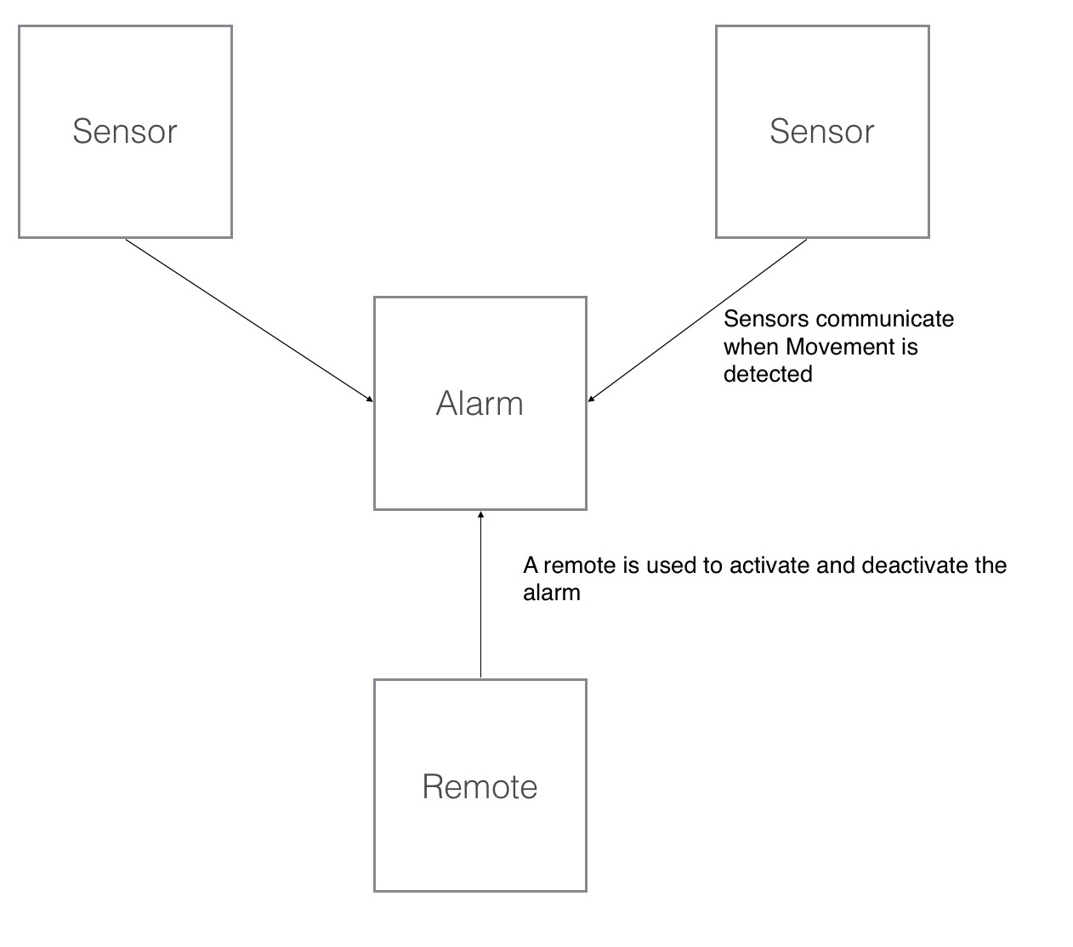
High level overview

Slide 13
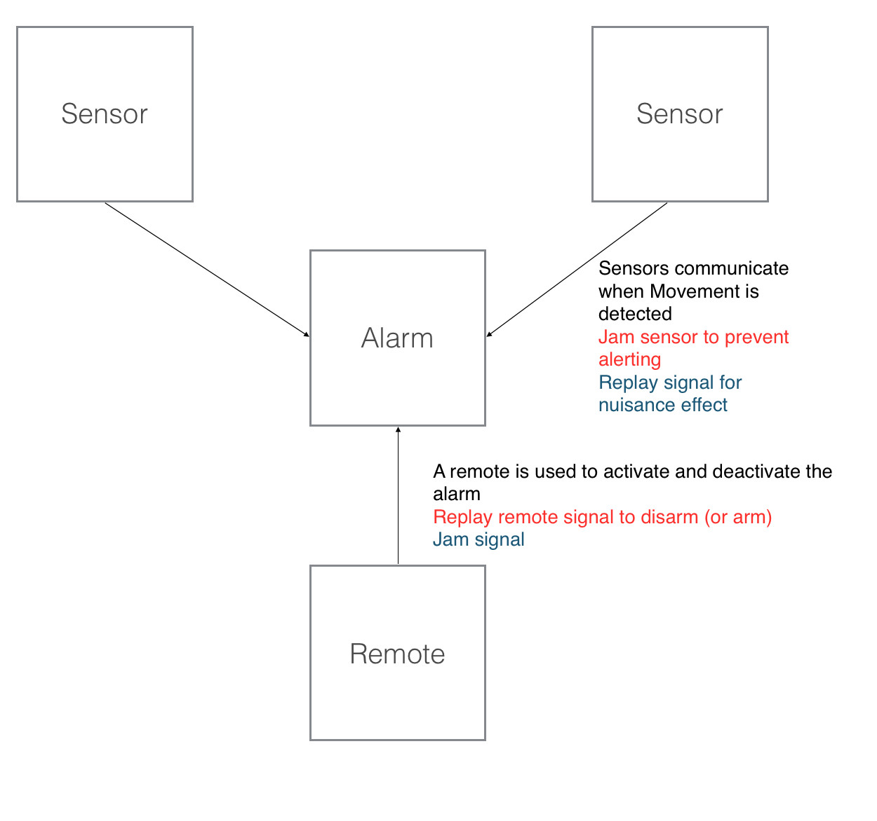
How do we attack?

Slide 14
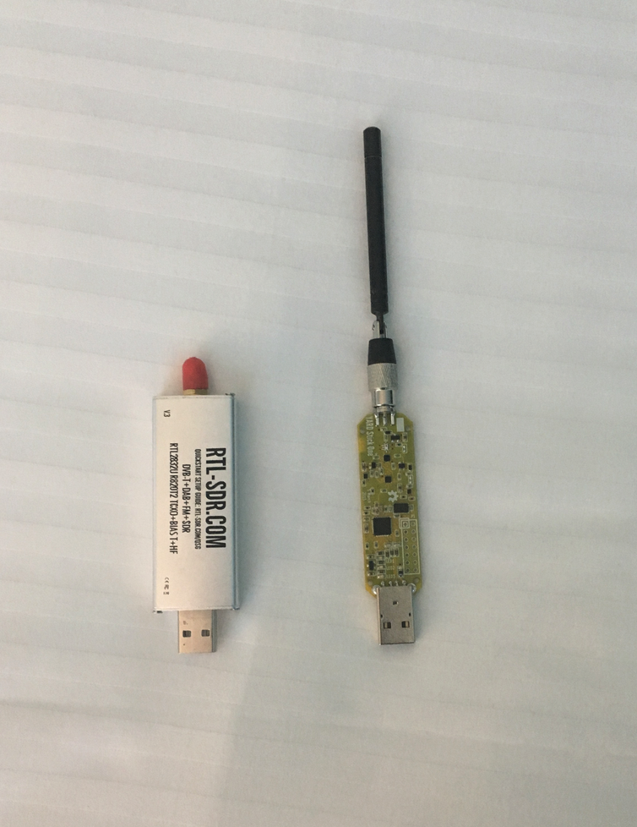
Tools required
Applications:
sudo apt get gqrx audacity python-usb rfcat
pip install ooktools

Slide 15
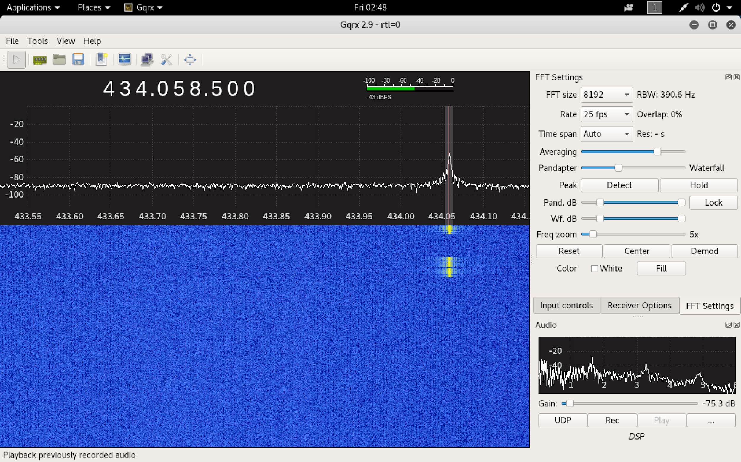
Part 1: recon
We need to identify the frequency the remote and sensors are transmitting & receiving on.
GQRX will assist

Slide 16
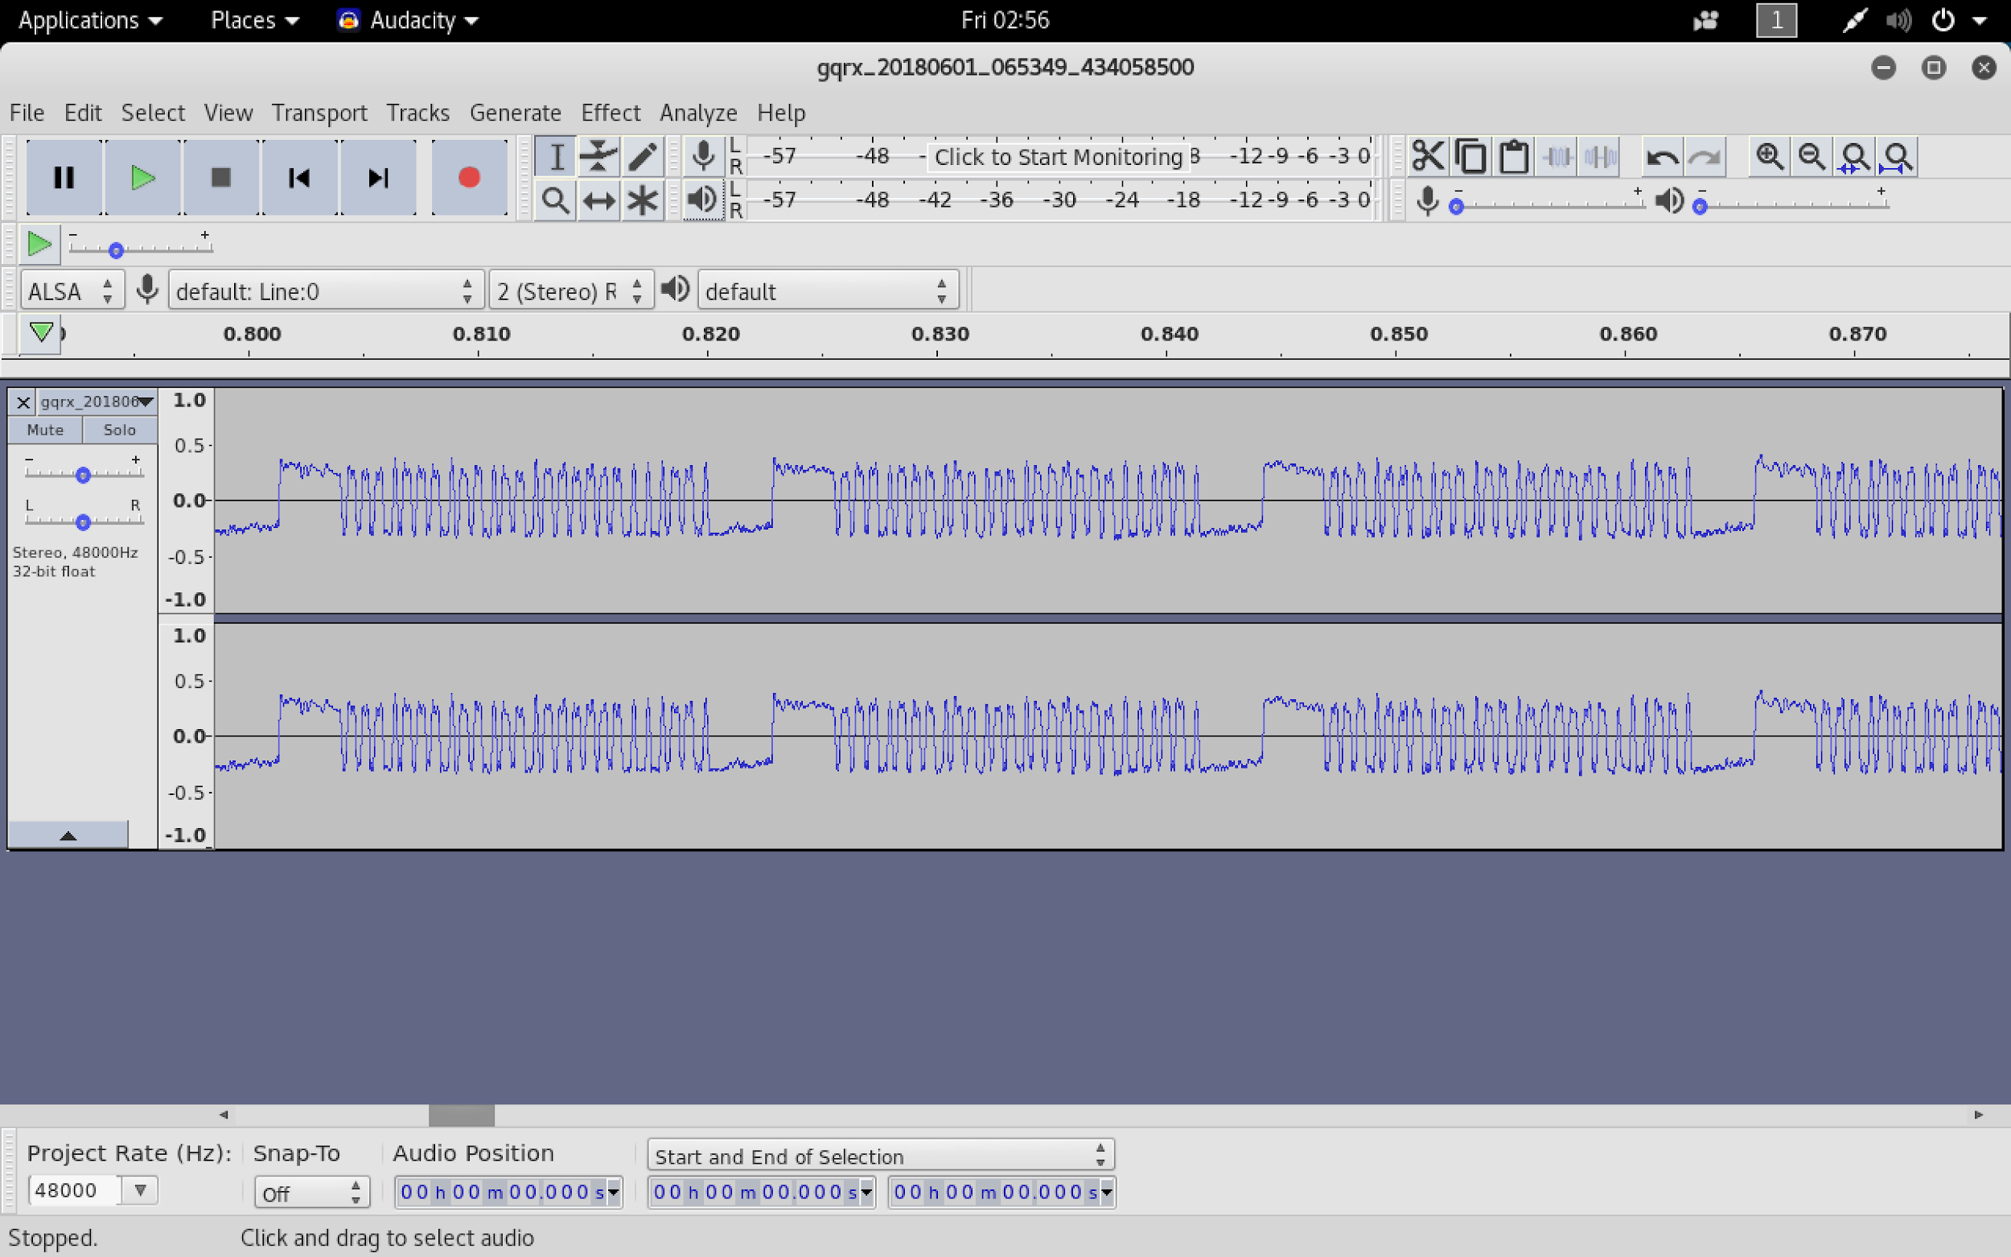
Part 2: record and analyse
Record what's being transmitted and analyse in audacity
This is what we call on off keying

Slide 17
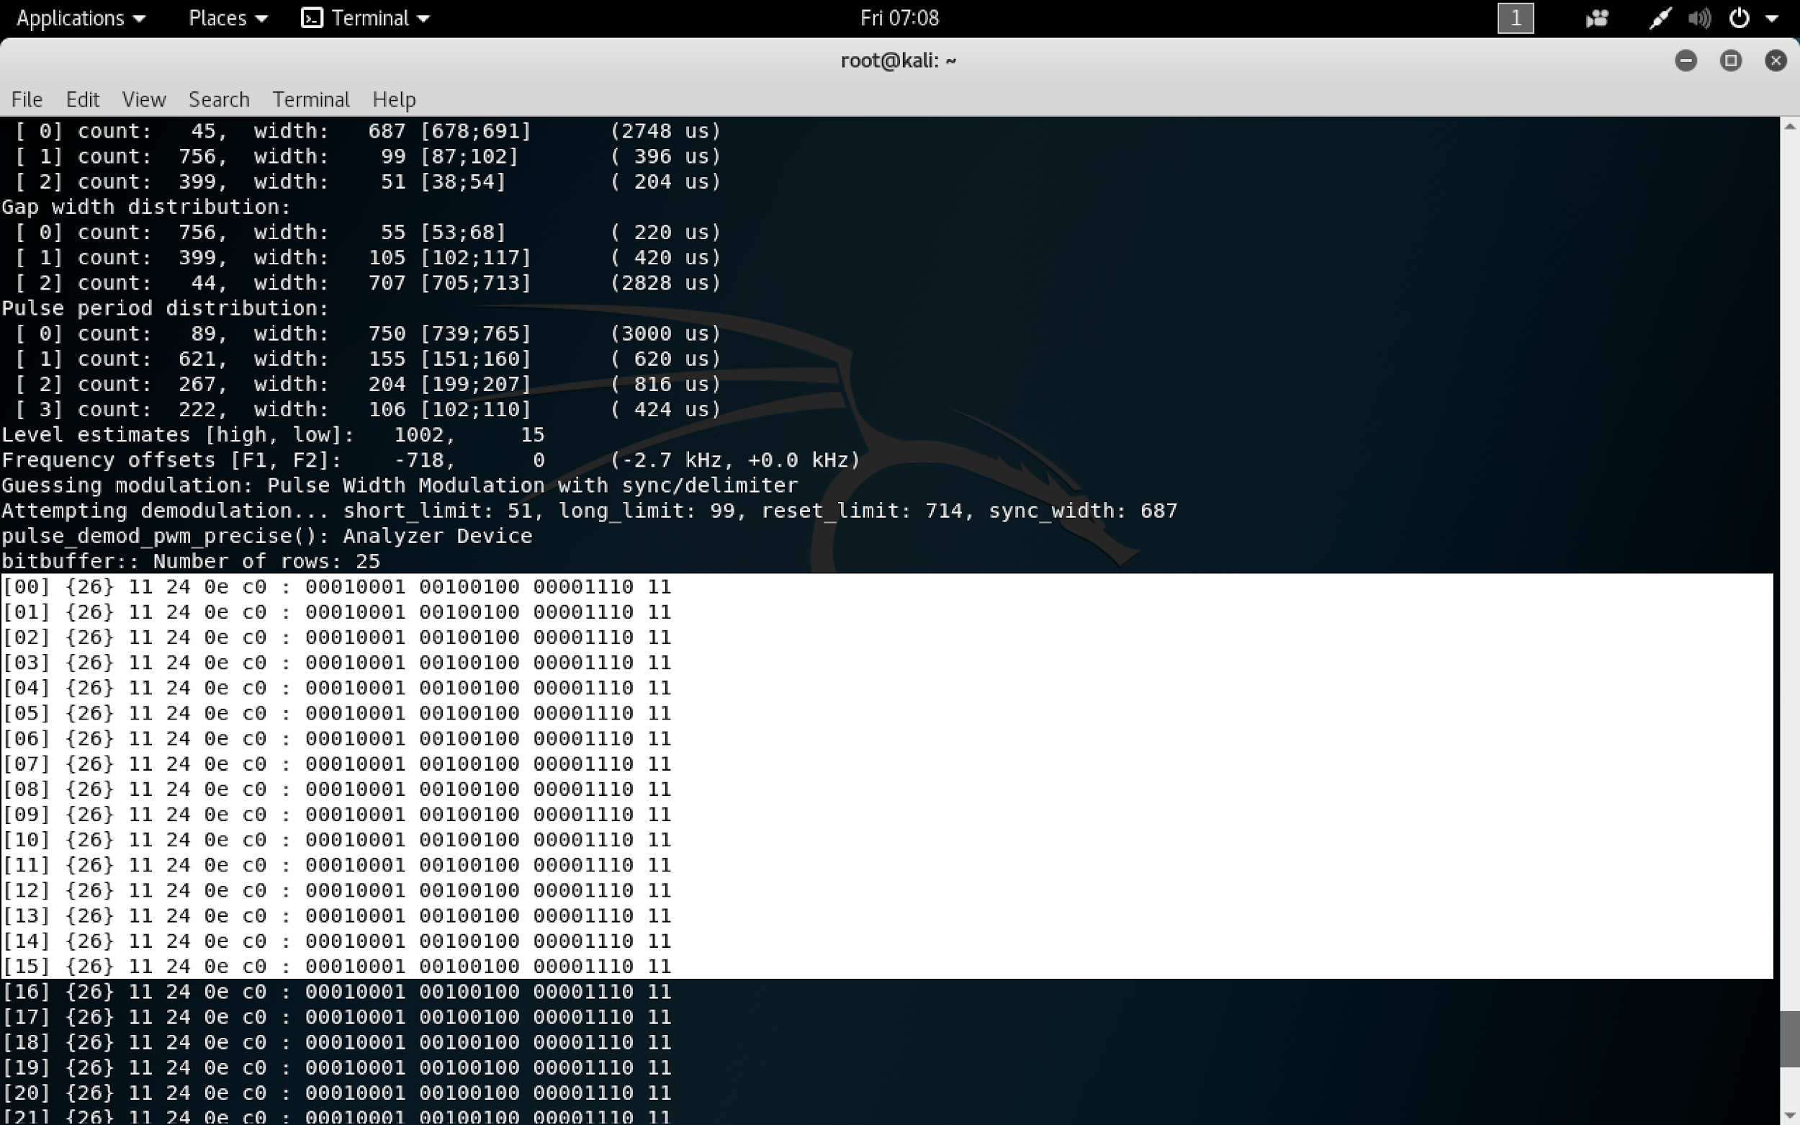
Other tools- rtl_433
https://github.com/merbanan/rtl_433
This allows us to demodulate what’s being sent.
Look at the difference between arm & disarm.

Slide 18
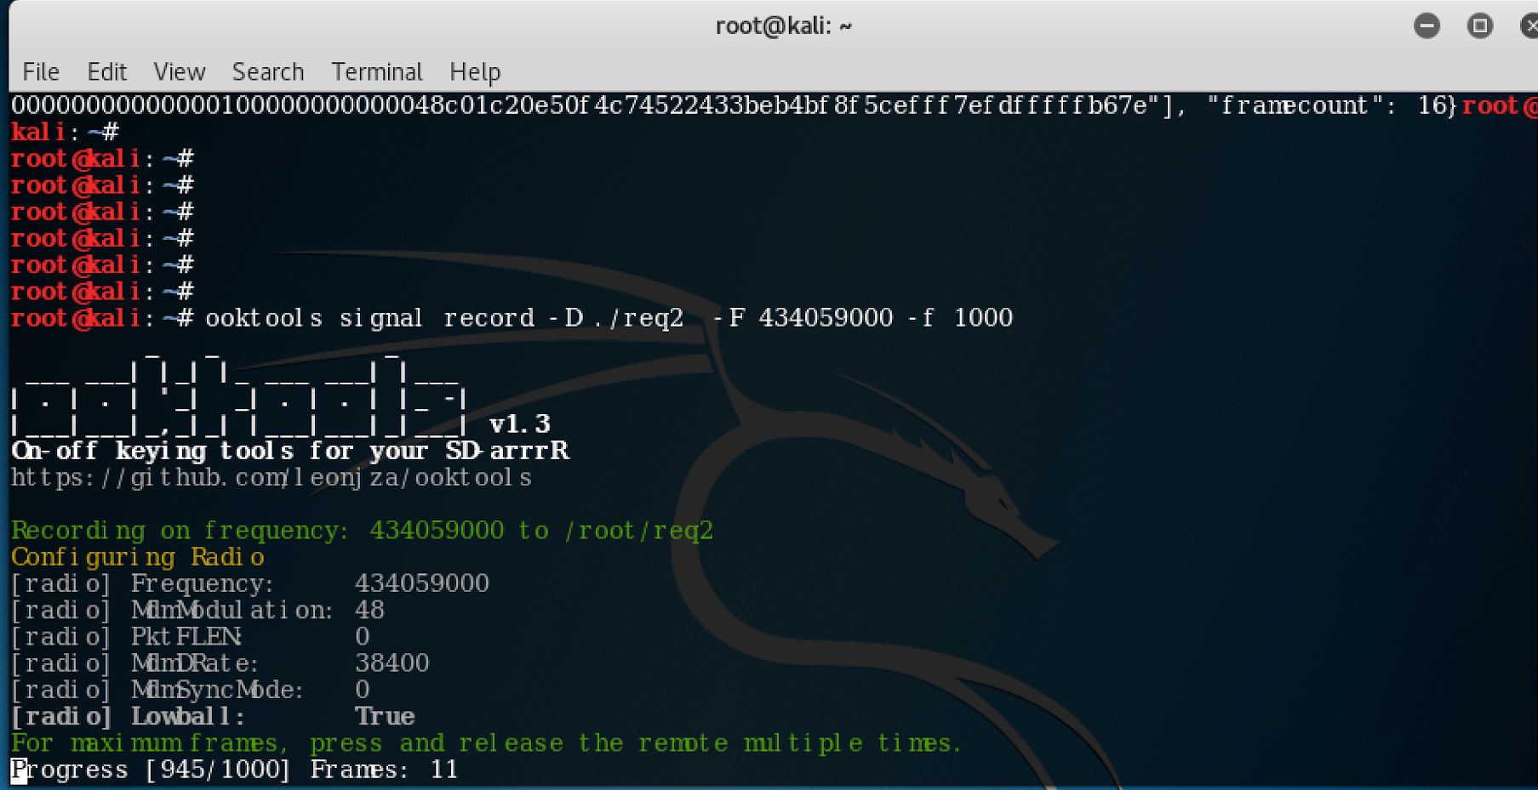
An easier way to identify | record | analyse
Ooktools comes with a similar set of tools that can be used in concert with gqrx/audacity
Commands:
ooktools signal search -S 434000000 -E 434100000 -i 10000
ooktools signal record -D ./arlec_202 -F 434059000 -f 1000

Slide 19
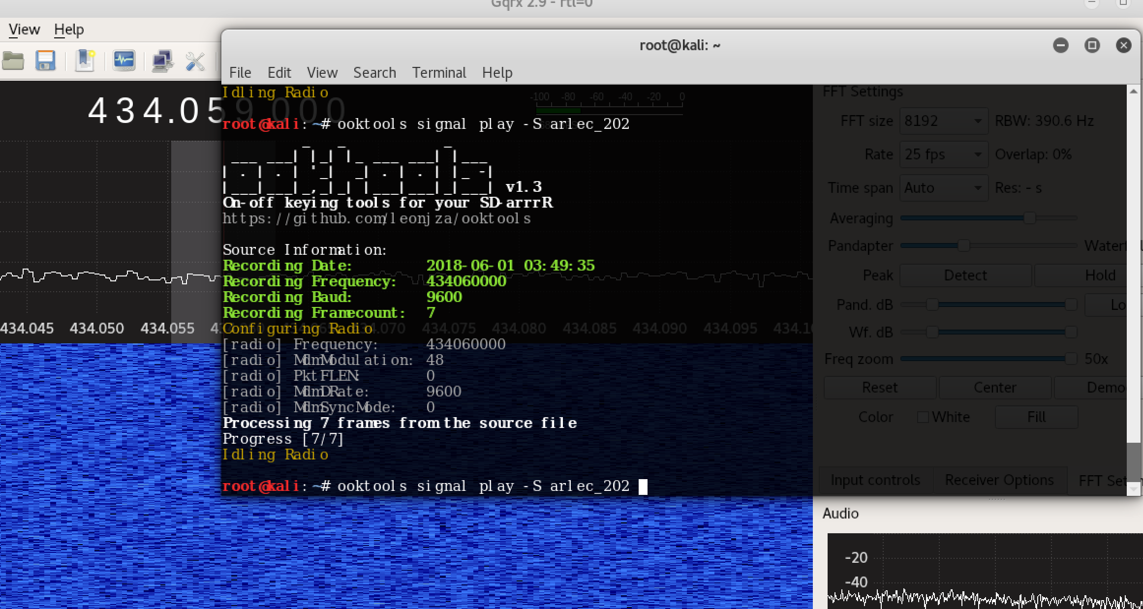
Replaying
Using ooktools, we can record & replay the signal
Typically need to record several requests
ooktools signal record -D ./arlec_202 -F 434060000 -f 100 -b 9600
ooktools signal play -S ./arlec_202

Slide 20
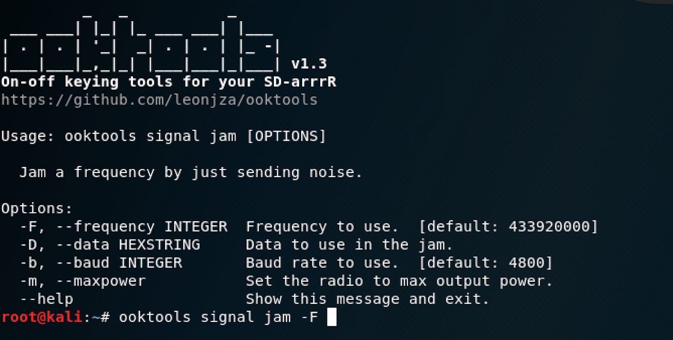
Jamming
Jamming is another option available to us...
ooktools signal jam -F <freq>

Slide 21
2nd target

Slide 22

Home monitoring & security system
Panasonic KX-HNB600AZ (Our attacks will be based off issues discovered in the KK-HNB600)
Retails for $200 from costco
Designed as a home alarm system
The system communicates to individual devices over DECT
The hub acts as a bridge

Slide 23
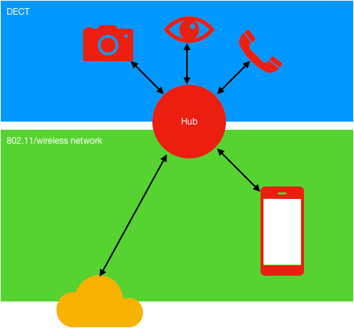
An overview

Slide 24
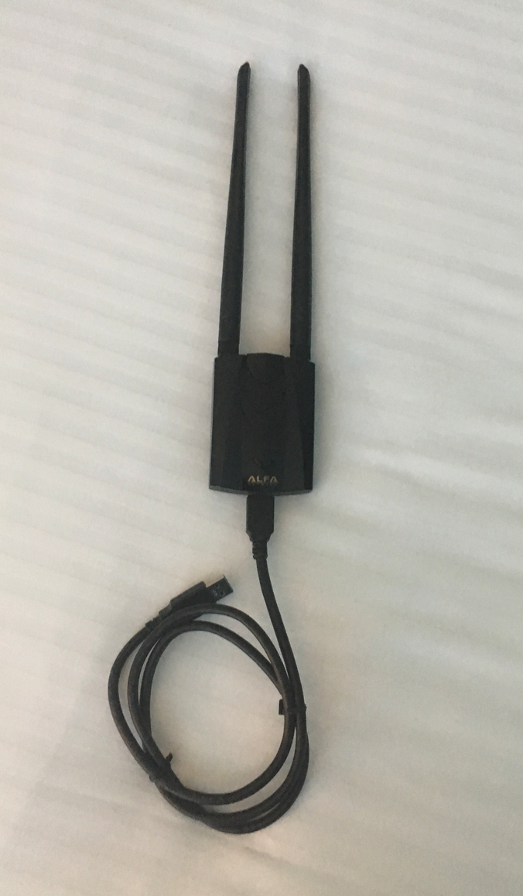
Step 1- 802.11 traffic capture
Look for the network “internet” and conduct a wireshark capture of the network. This can be done through the aircrack suite.
airmon-ng start wlan0
airodump-ng wlan0mon

Slide 25
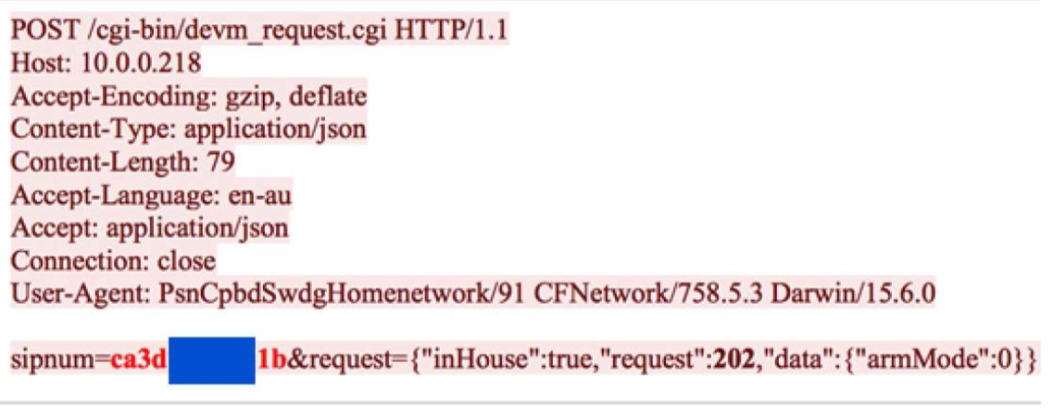
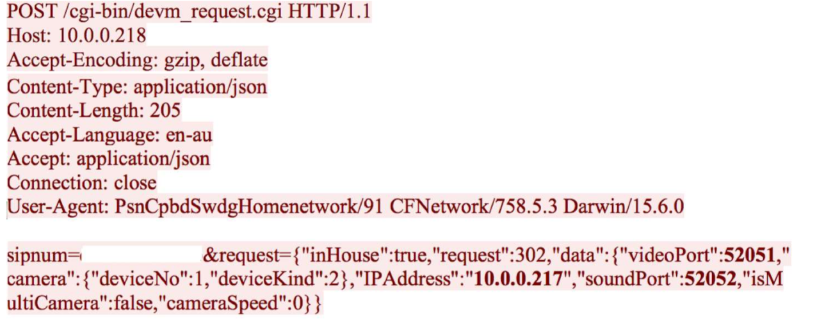
Step 2- traffic analysis
Go through the wireshark captures
All requests are sent in clear text & without auth (except SIP number)
SIP number…

Slide 26
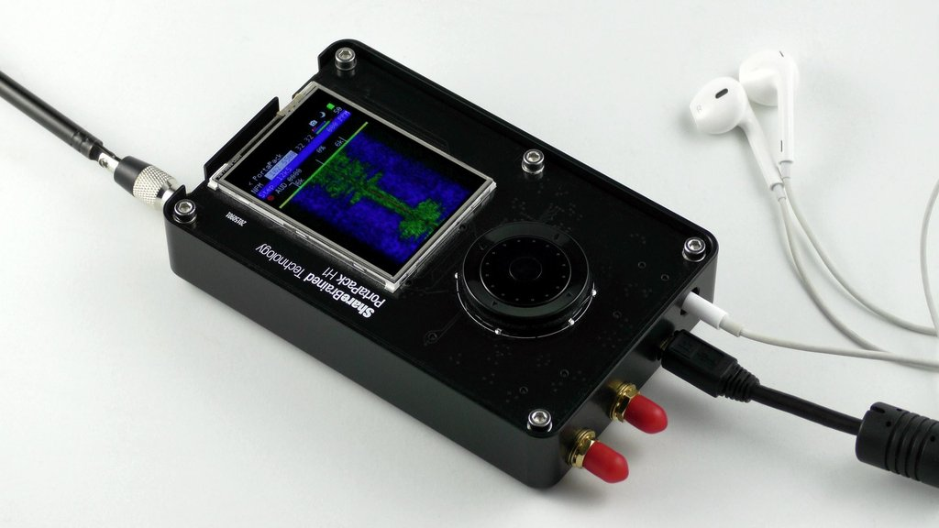
Other attacks?
Using the portapack, it is possible to capture/analyse or jam DECT?

Slide 27
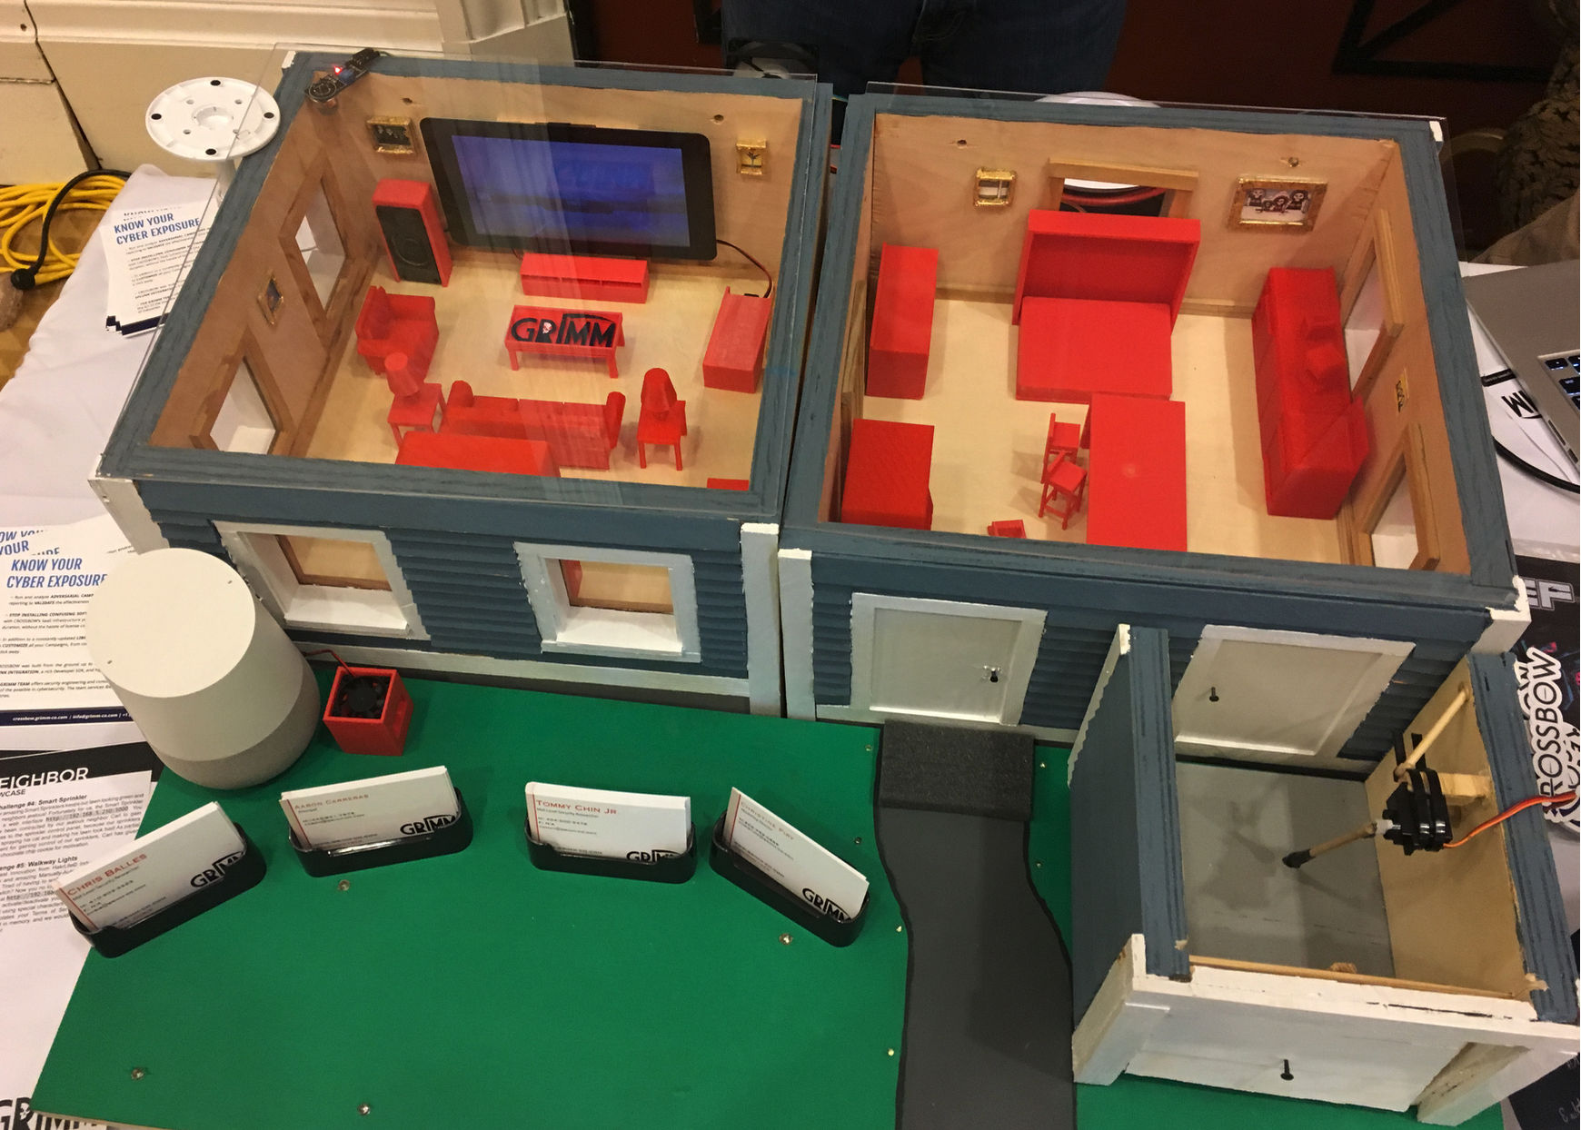
Whats next?
These systems are “mutually supporting”
Understand their role/context and what these issues actually mean

Slide 28
Conclusion
This is an intro into breaking wireless systems that have a security function
You should have a appreciation of how to conduct jamming, replaying & capturing wireless signals in COTS security products.

Slide 29
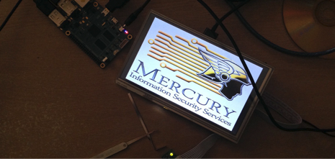

Questions?
E: info@mercuryiss.com.au

